Slide 1
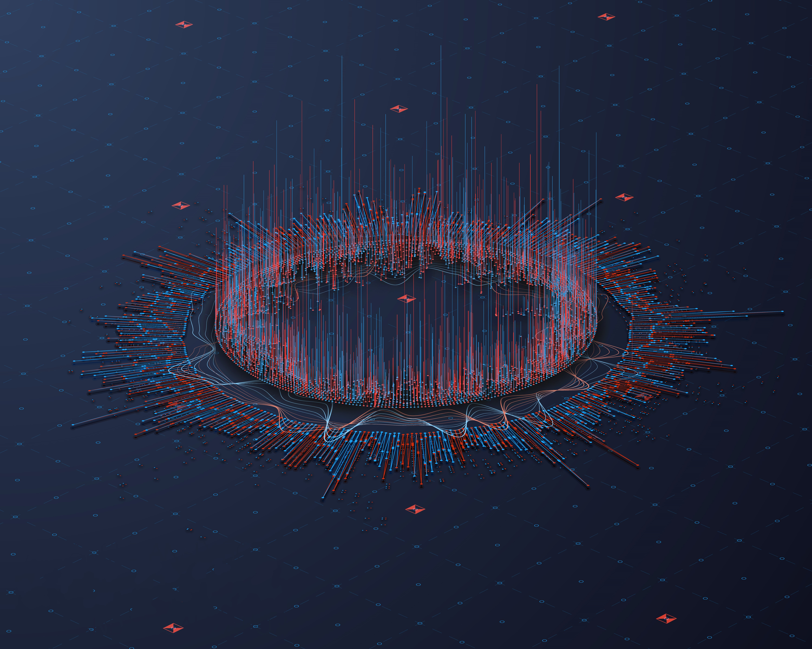
Data Representation

Slide 2

Table of Contents
Introduction
Number System
Number Conservation
Binary Arithmetic
Logic Gate
Brief Table of Contents.

Slide 3
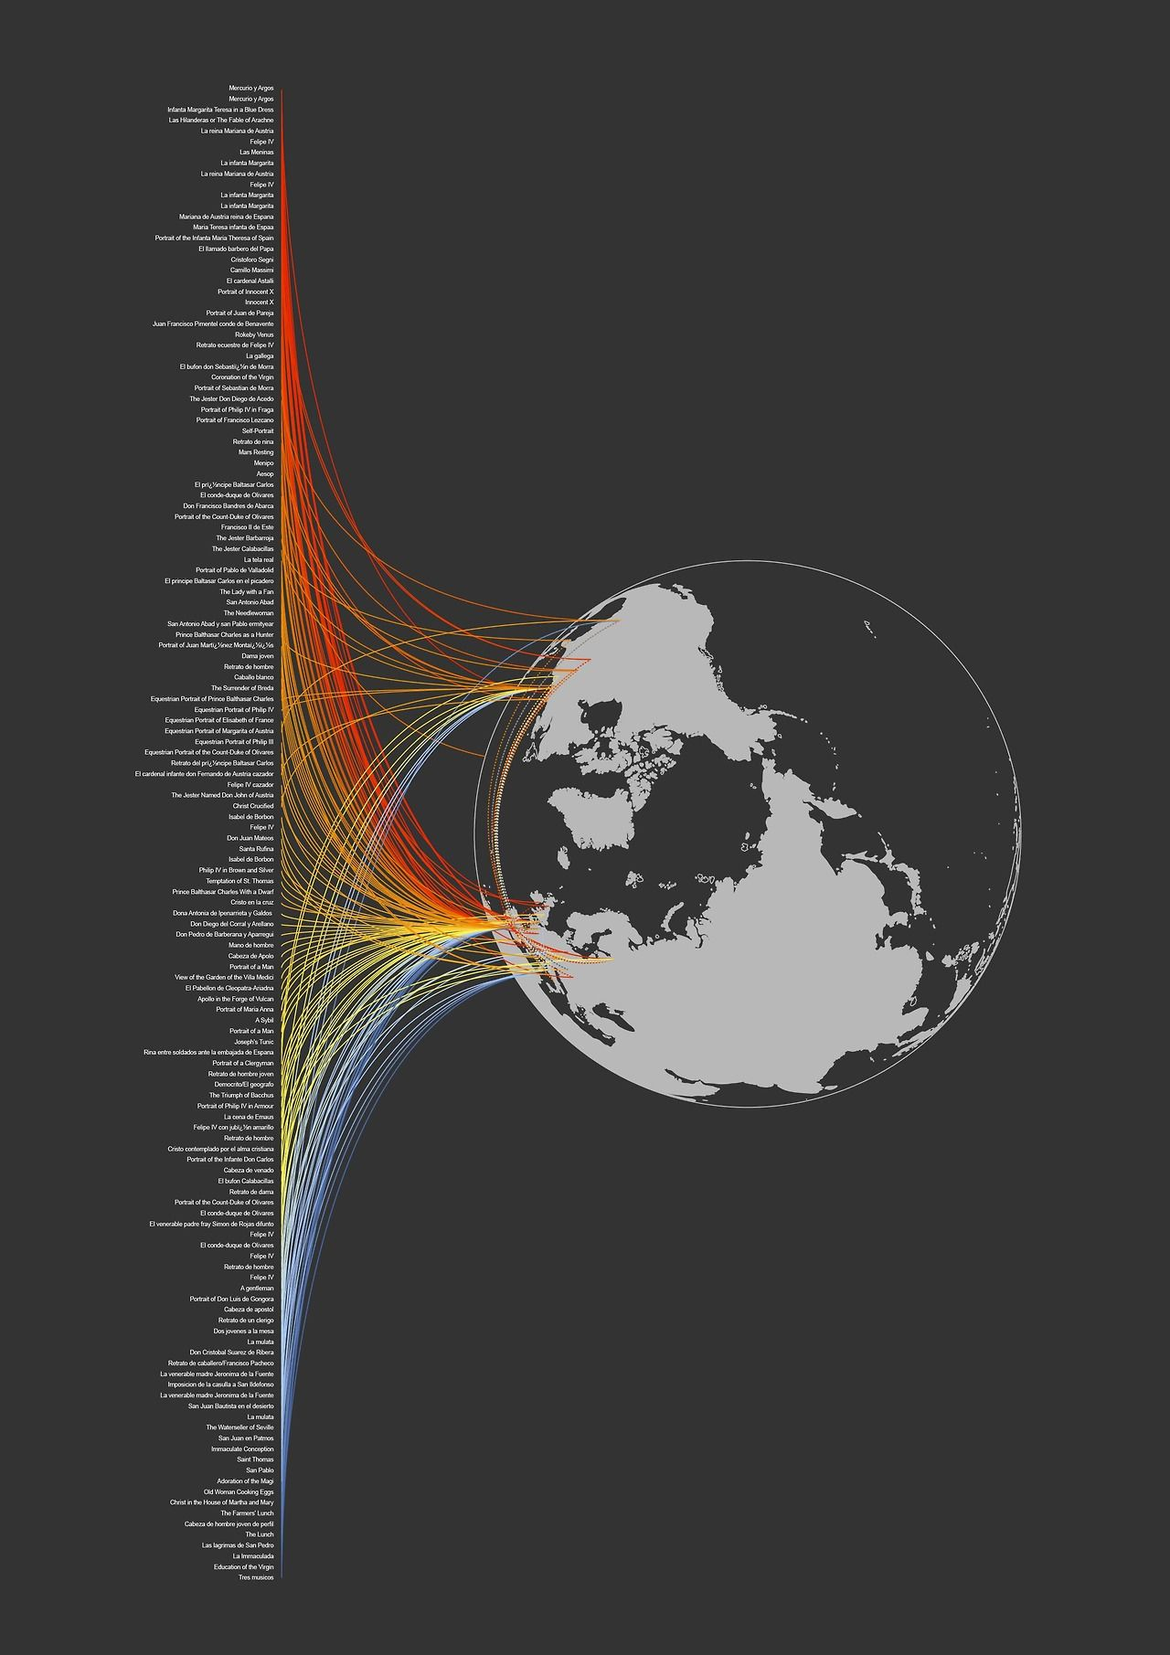
Introduction
In computer systems, data refers to symbols used to represent numbers, text, events, sounds, images, people, things, ideas, etc.

Slide 4
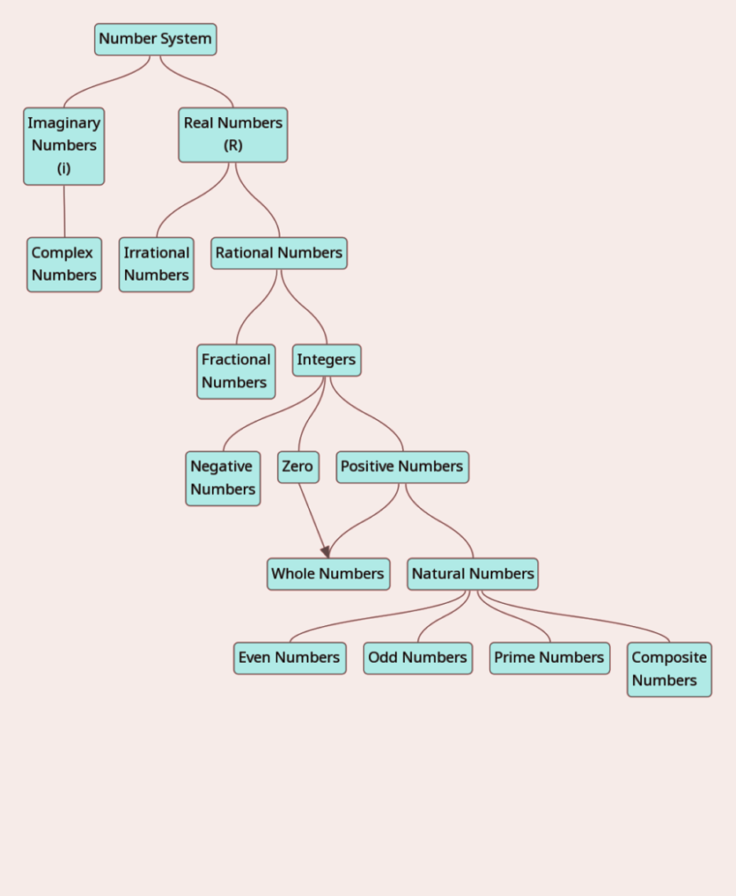
Number System
Number system is a basis for counting various items.
Number system is a way to represent or express numbers.
Number system refers to the digits, its arrangements, positional value and base of number system.
Types of Number System
Non Positional Number System
Positional Number System

Slide 5
Positional Number System
Types of Positional Number System
A positional number system is one in which a number's position represents different values ​​depending on the position it occupies in the number.
Few symbols are used and the value of each digit is determined by three considerations.
The digit itself
The position of digit in the number
The base of the number system
The rightmost digit have minimum and leftmost digit have maximum positional weight.
Decimal Number System – (Base 10)
Binary Number System – (Base 2)
Octal Number System – (Base 8)
Hexadecimal Number System – (Base 16)

Slide 6
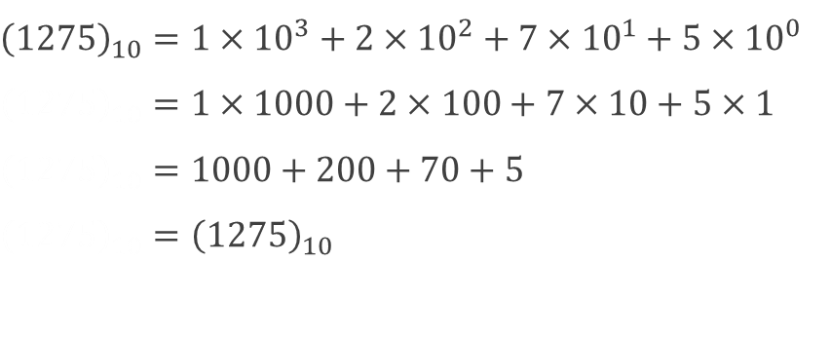
Decimal Number System
A number system having base 10 is called decimal number system.
Decimal number system is very popular in our day-to-day life.
Characteristics of decimal number system
Example
Uses ten digits 0, 1, 2, 3, 4, 5, 6, 7, 8 and 9
Redix(r) = 10
$${\left(1275\right)}_{10}=1×{10}^{3}+2×{10}^{2}+7×{10}^{1}+5×{10}^{0}$$
$${\left(1275\right)}_{10}=1×1000+2×100+7×10+5×1$$
$${\left(1275\right)}_{10}=1000+200+70+5$$
$${\left(1275\right)}_{10}={\left(1275\right)}_{10}$$

Slide 7
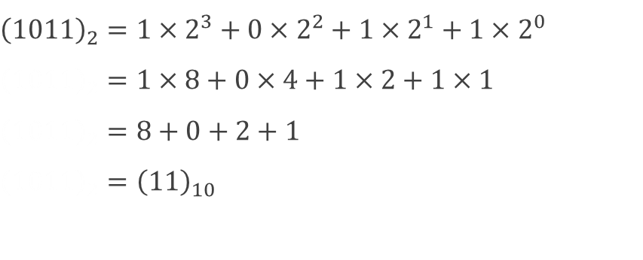
Binary Number System
A number system having base 2 is called binary number system.
Used in computer system.
Characteristics of binary number system
Example
Uses two digits 0 and 1
Redix(r) = 2
$${\left(1011\right)}_{2}=1×2^{3}+0×2^{2}+1×2^{1}+1×2^{0}$$
$${\left(1011\right)}_{2}=1×8+0×4+1×2+1×1$$
$${\left(1011\right)}_{2}=8+0+2+1$$
$${\left(1011\right)}_{2}={\left(11\right)}_{10}$$

Slide 8
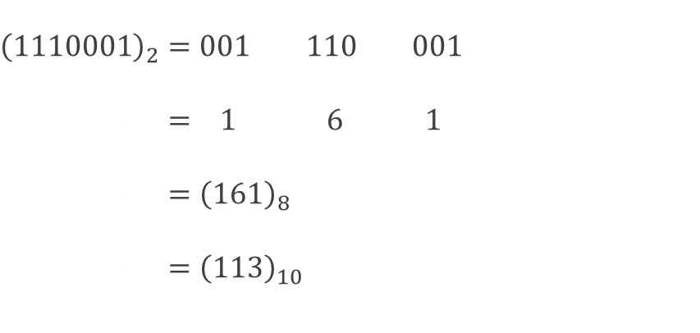
Octal Number System
A number system having base 8 is called octal number system.
Characteristics of octal number system
Example
Uses two digits 0, 1, 2, 3, 4, 5, 6 and 7
Redix(r) = 8
$${\left(1110001\right)}_{2}=001 110 001$$
$${\left(1110001\right)}_{2}= 1 6 1$$
$${\left(1110001\right)}_{2}={\left(161\right)}_{8}$$
$${\left(1110001\right)}_{2}={\left(113\right)}_{10}$$

Slide 9
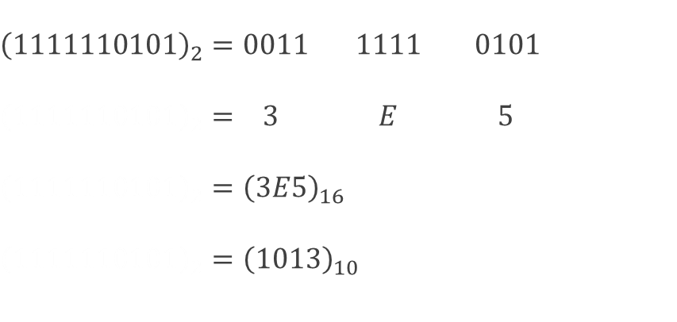
Hexadecimal Number System
A number system having base 16 is called hexadecimal number system.
Characteristics of hexadecimal number system
Example
Uses ten digits and six letters 0, 1, 2, 3, 4, 5, 6, 7, 9, A, B, C, D, E and F
Redix(r) = 16
$${\left(1111110101\right)}_{2}=0011 1111 0101$$
$${\left(1111110101\right)}_{2}= 3 E 5$$
$${\left(1111110101\right)}_{2}={\left(3E5\right)}_{16}$$
$${\left(1111110101\right)}_{2}={\left(1013\right)}_{10}$$

Slide 10
Decimal | Binary | Octal | Hexadecimal
0 | 0000 | 000 | 0
1 | 0001 | 001 | 1
2 | 0010 | 002 | 2
3 | 0011 | 003 | 3
4 | 0100 | 004 | 4
5 | 0101 | 005 | 5
6 | 0110 | 006 | 6
7 | 0111 | 007 | 7
8 | 1000 | 010 | 8
9 | 1001 | 011 | 9
10 | 1010 | 012 | A
11 | 1011 | 013 | B
12 | 1100 | 014 | C
13 | 1101 | 015 | D
14 | 1110 | 016 | E
15 | 1111 | 017 | F

Slide 11
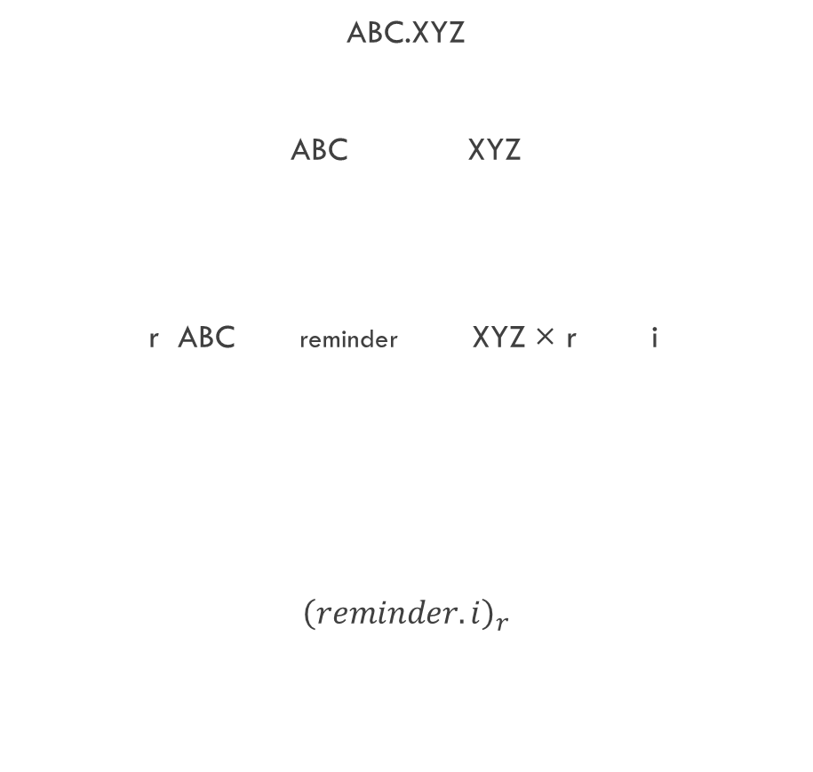
Number Conversion
ABC.XYZ
ABC XYZ
r ABC reminder XYZ × r i
$${\left(reminder.i\right)}_{r}$$
Decimal to base-r system
Separate the number into integer and fractional part
Divide “integer part” by base r repeatedly until the quotient becomes zero and storing remainders at each step
Multiply “fractional part” by r and accumulate the integer digits so obtained
Combine the accumulated result and parenthesis, the whole result with subscript r.

Slide 12
Decimal to Binary
Rules
Example
Divide the given number by 2 and note their remainder
Repeatedly divide the quotient by 2 and note the remainder until quotient reduced 0.
Collect the remainders, last obtained first and first obtained last to get binary equivalent.
2 75
1
37
1
18
0
9
1
4
0
2
0
1
1
0
$${\left(75\right)}_{10}={\left(1001011\right)}_{2}$$

Slide 13
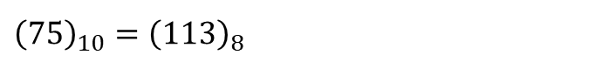
Decimal to Octal
Rules
Example
Divide the given number by 8 and note their remainder
Repeatedly divide the quotient by 8 and note the remainder until quotient reduced 0.
Collect the remainders, last obtained first and first obtained last to get binary equivalent.
8 75
3
9
1
1
1
0
$${\left(75\right)}_{10}={\left(113\right)}_{8}$$

Slide 14
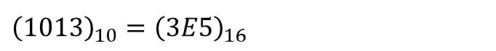
Decimal to Hexadecimal
Rules
Example
Divide the given number by 16 and note their remainder
Repeatedly divide the quotient by 16 and note the remainder until quotient reduced 0.
Collect the remainders, last obtained first and first obtained last to get binary equivalent.
16 1013
5
63
E
3
3
0
$${\left(1013\right)}_{10}={\left(3E5\right)}_{16}$$

Slide 15
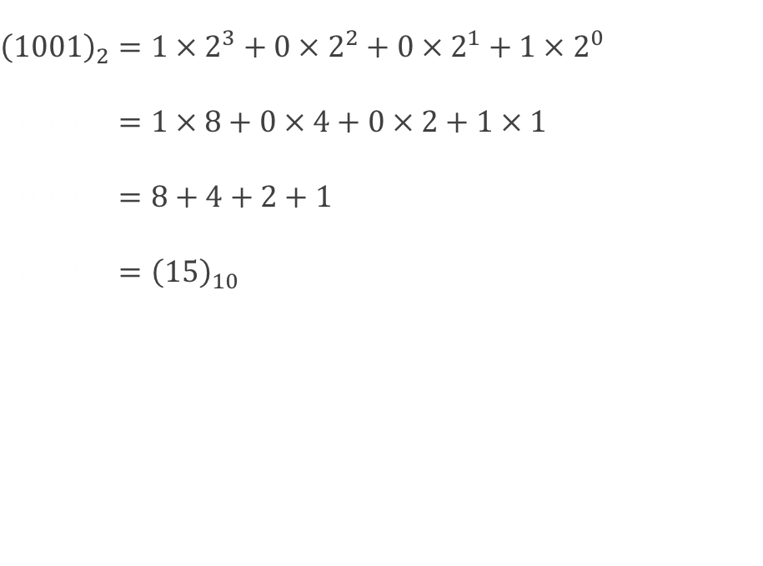
Binary to Decimal
Rules
Example
Multiply each bit by corresponding power of 2 (base)
Sum each product term to get decimal equivalent number.
$${\left(1001\right)}_{2}=1×2^{3}+0×2^{2}+0×2^{1}+1×2^{0}$$
$${\left(1001\right)}_{2}=1×8+0×4+0×2+1×1$$
$${\left(1001\right)}_{2}=8+4+2+1$$
$${\left(1001\right)}_{2}={\left(15\right)}_{10}$$

Slide 16
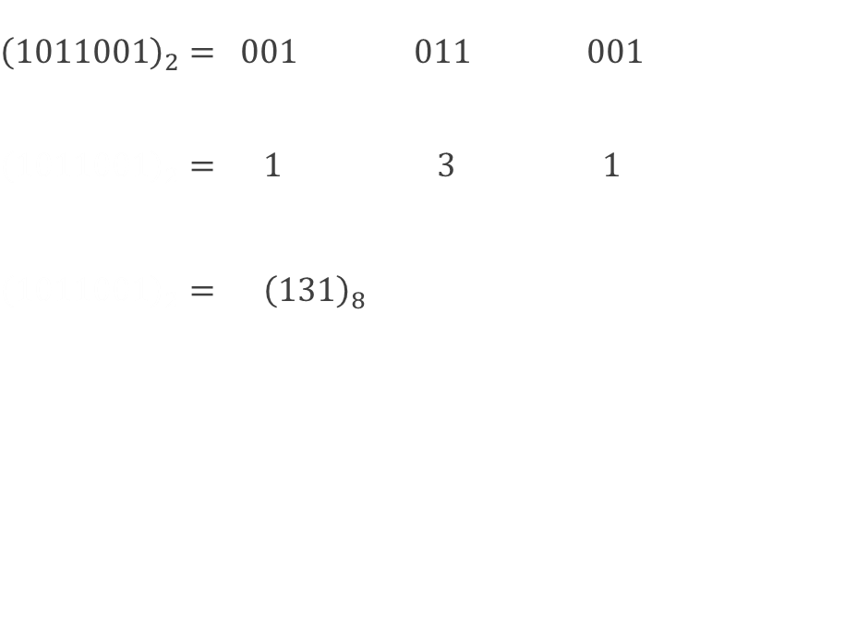
Binary to Octal
Rules
Example
Divide given binary number into group of three bits from binary point right.
Substitute each group of three bits by octal equivalent.
Collect octal digits to get equivalent number
$${\left(1011001\right)}_{2}= 001 011 001$$
$${\left(1011001\right)}_{2}= 1 3 1$$
$${\left(1011001\right)}_{2}= {\left(131\right)}_{8}$$

Slide 17
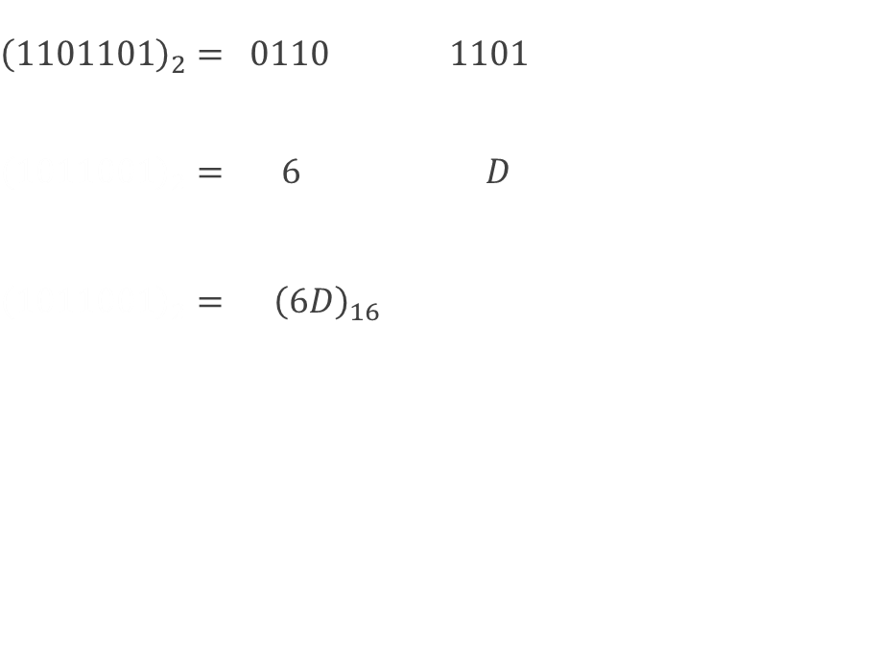
Binary to Hexadecimal
Rules
Example
Divide given binary number into group of four bits from binary point right.
Substitute each group of three bits by hexadecimal equivalent.
Collect octal hexadecimal to get equivalent number
$${\left(1101101\right)}_{2}= 0110 1101$$
$${\left(1011001\right)}_{2}= 6 D$$
$${\left(1011001\right)}_{2}= {\left(6D\right)}_{16}$$

Slide 18
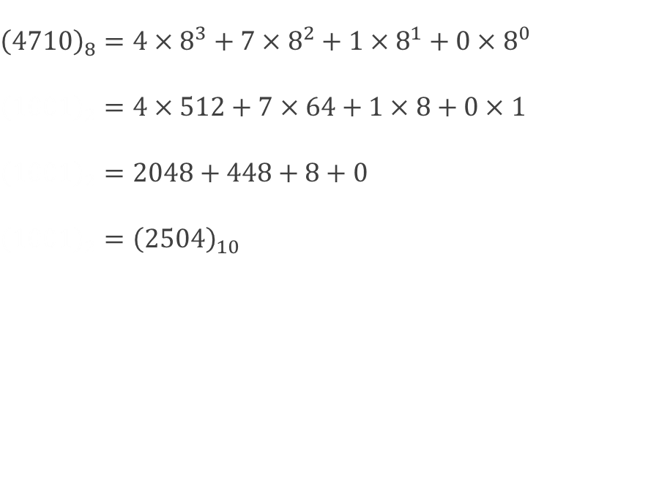
Octal to Decimal
Rules
Example
Multiply each octal digit by corresponding power of 8 (base)
Sum each product term to get decimal equivalent number.
$${\left(4710\right)}_{8}=4×8^{3}+7×8^{2}+1×8^{1}+0×8^{0}$$
$${\left(1001\right)}_{2}=4×512+7×64+1×8+0×1$$
$${\left(1001\right)}_{2}=2048+448+8+0$$
$${\left(1001\right)}_{2}={\left(2504\right)}_{10}$$

Slide 19
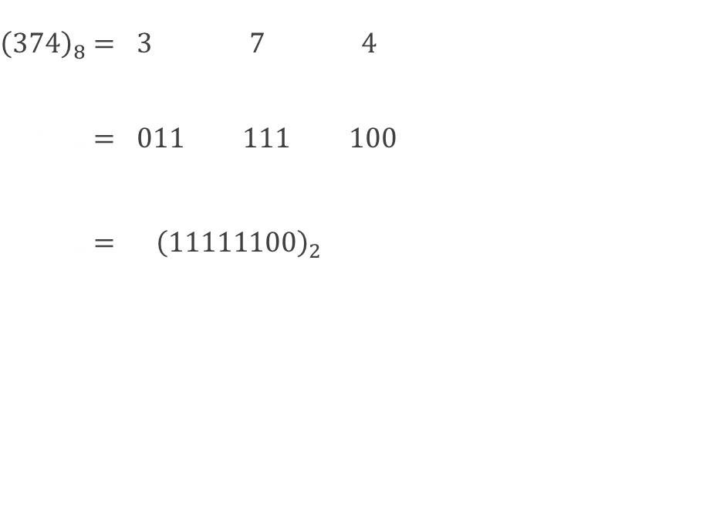
Octal to Binary
Rules
Example
Substitute each octal digit by equivalent 3 bit binary
Collect for each digit to get binary equivalent number
$${\left(374\right)}_{8}= 3 7 4$$
$${\left(374\right)}_{8}= 011 111 100$$
$${\left(374\right)}_{8}= {\left(11111100\right)}_{2}$$

Slide 20
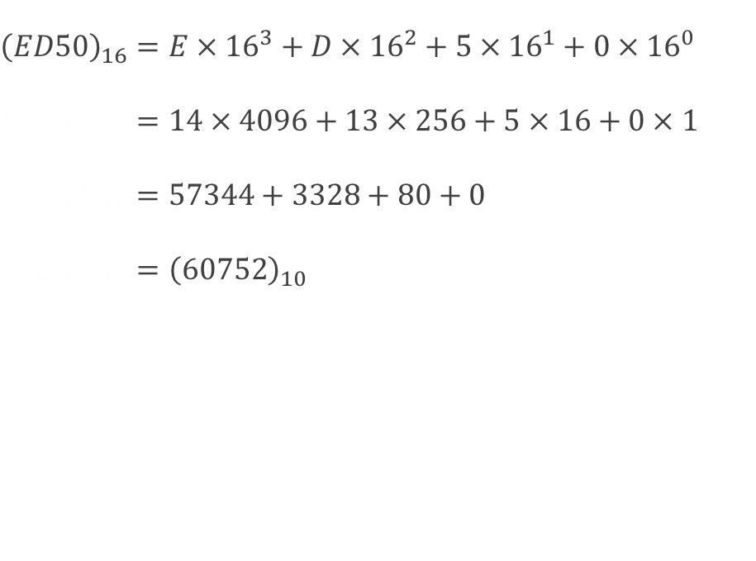
Hexadecimal to Decimal
Rules
Example
Multiply each octal digit by corresponding power of 16 (base)
Sum each product term to get decimal equivalent number.
$${\left(ED50\right)}_{16}=E×{16}^{3}+D×{16}^{2}+5×{16}^{1}+0×{16}^{0}$$
$${\left(ED50\right)}_{16}=14×4096+13×256+5×16+0×1$$
$${\left(ED50\right)}_{16}=57344+3328+80+0$$
$${\left(ED50\right)}_{16}={\left(60752\right)}_{10}$$

Slide 21
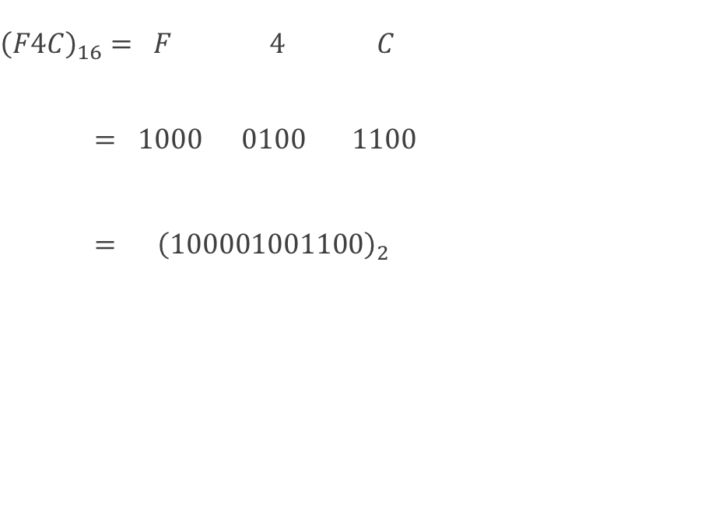
Hexadecimal to Binary
Rules
Example
Substitute each hexadecimal digit by equivalent 4 bit binary
Collect for each digit to get binary equivalent number
$${\left(F4C\right)}_{16}= F 4 C$$
$${\left(374\right)}_{8}= 1000 0100 1100$$
$${\left(374\right)}_{8}= {\left(100001001100\right)}_{2}$$

Slide 22
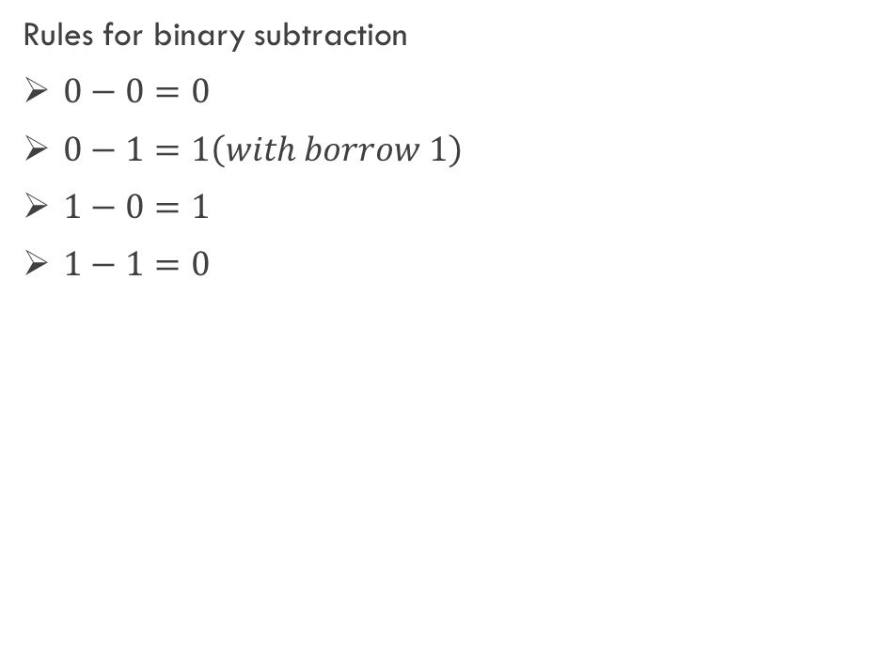
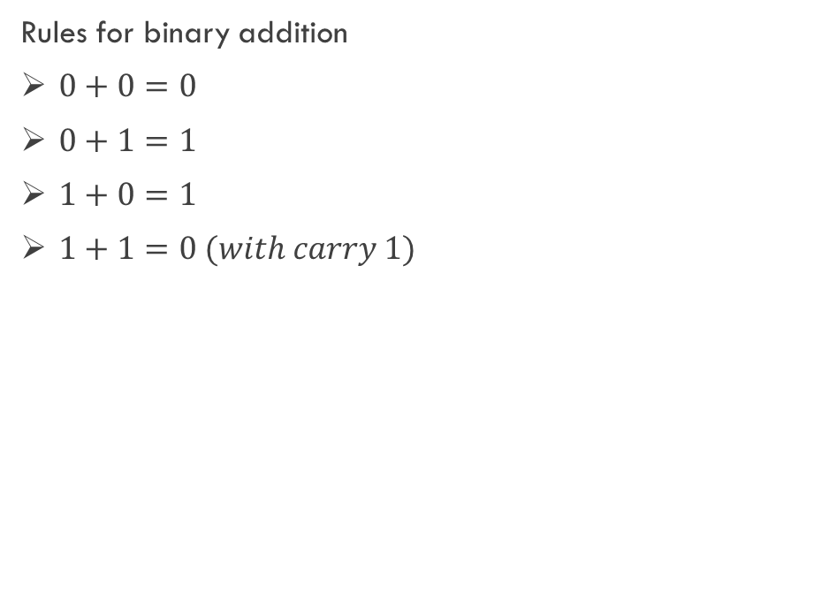
Binary Arithmetic
Binary Addition
Binary Subtraction
Rules for binary addition
$0+0=0$
$0+1=1$
$1+0=1$
$1+1=0 (with carry 1)$
Rules for binary subtraction
$0−0=0$
$0−1=1\left(with borrow 1\right)$
$1−0=1$
$1−1=0$

Slide 23
Subtraction using complement
Complement are used in the digital computer to simplify the subtraction operation and for logical manipulations. There are two types of complements in binary number system, 1’s complement and 2’s complement.
Rules
Make equal number of bits in both subtrahend and minuend
Find 1’s / 2’s complement of subtrahend
Add minuend to it
In 1’s
If sum produce carry, add it to LSB of the sum (Ans is +ve)
If sum doesn’t produce carry, take 1’s complement of result (Ans is -ve)
In 2’s
If sum produce carry, discard it (Ans is +ve)
If sum doesn’t produce carry, take 2’s complement of result (Ans is -ve)
How to find 1’s complement?
Subtract each bit from 1.
How to find 2’s complement?
Find 1’s complement and add 1 to LSB.

Slide 24
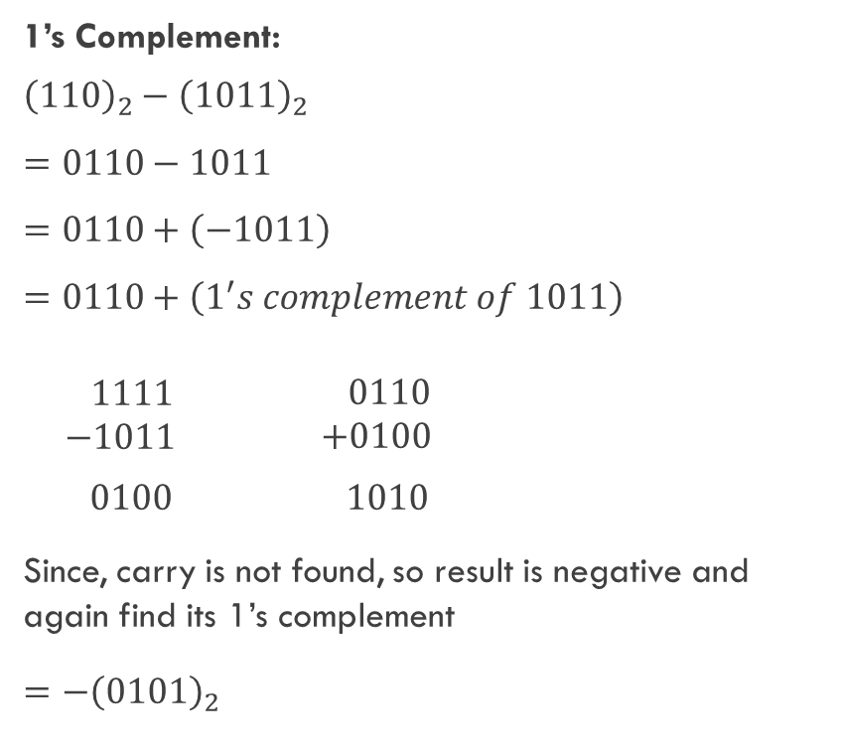
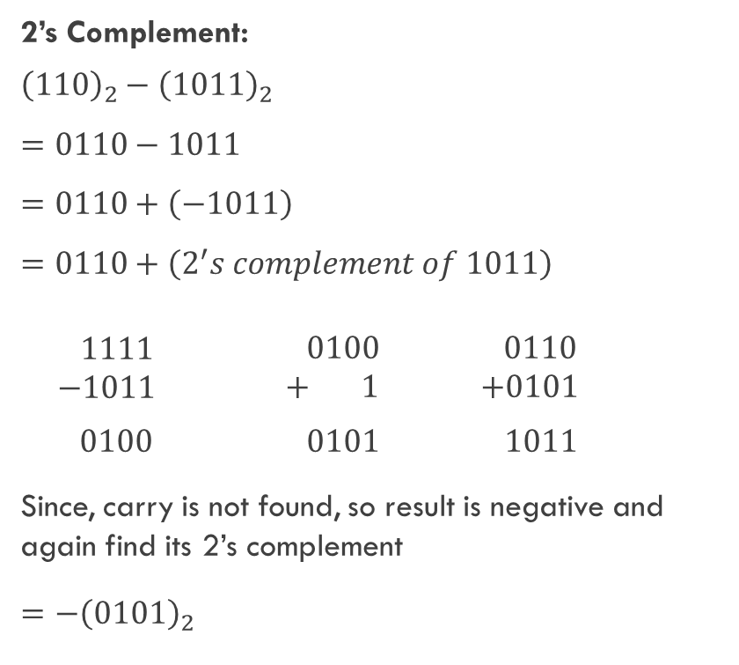
Example
Perform 1’s complement and 2’s complement of ${\left(110\right)}_{2}−{\left(1011\right)}_{2}$
1’s Complement:
$${\left(110\right)}_{2}−{\left(1011\right)}_{2}$$
$$=0110−1011$$
$$=0110+\left(−1011\right)$$
$$=0110+\left(1^{′}s complement of 1011\right)$$
$\begin{matrix} 1111 \\ −1011\end{matrix}$ $\begin{matrix} 0110 \\ +0100\end{matrix}$
$$0100 1010$$
Since, carry is not found, so result is negative and again find its 1’s complement
$$={−\left(0101\right)}_{2}$$
2’s Complement:
$${\left(110\right)}_{2}−{\left(1011\right)}_{2}$$
$$=0110−1011$$
$$=0110+\left(−1011\right)$$
$$=0110+\left(2^{′}s complement of 1011\right)$$
$\begin{matrix} 1111 \\ −1011\end{matrix}$ $\begin{matrix} 0100 \\ + 1\end{matrix}$ $\begin{matrix} 0110 \\ +0101\end{matrix}$
$$0100 0101 1011$$
Since, carry is not found, so result is negative and again find its 2’s complement
$$={−\left(0101\right)}_{2}$$

Slide 25
Logic Gate
A logic gate is an electronic circuit that operates on one or more input signals to produce an output signal. Gates are the hardware components, which produce signals 1 or 0 if input requirements are satisfied. Types of logic gates:
AND gate
OR gate
NOT gate
NAND gate
NOR gate

Slide 26
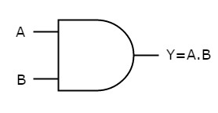
AND Gate
An electronic circuit have two or more than two input values and produce only one output value
Produce 1 output when all input are 1 otherwise the output will be 0
Truth Table
Algebraic Expression
O = A.B
Graphical Symbol
Inputs |  | Outputs
A | B | O = A.B
0 | 0 | 0
0 | 1 | 0
1 | 0 | 0
1 | 1 | 1

Slide 27
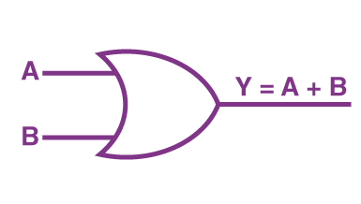
OR Gate
An electronic circuit have two or more than two input values and produce only one output value
Produce 0 output when all input are 0 otherwise the output will be 1
Truth Table
Algebraic Expression
Y = A+B
Graphical Symbol
Inputs |  | Outputs
A | B | Y = A+B
0 | 0 | 0
0 | 1 | 1
1 | 0 | 1
1 | 1 | 1

Slide 28
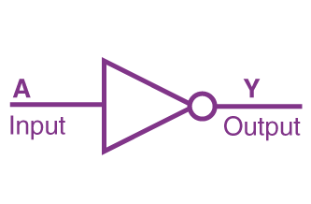
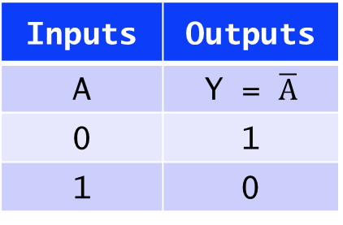
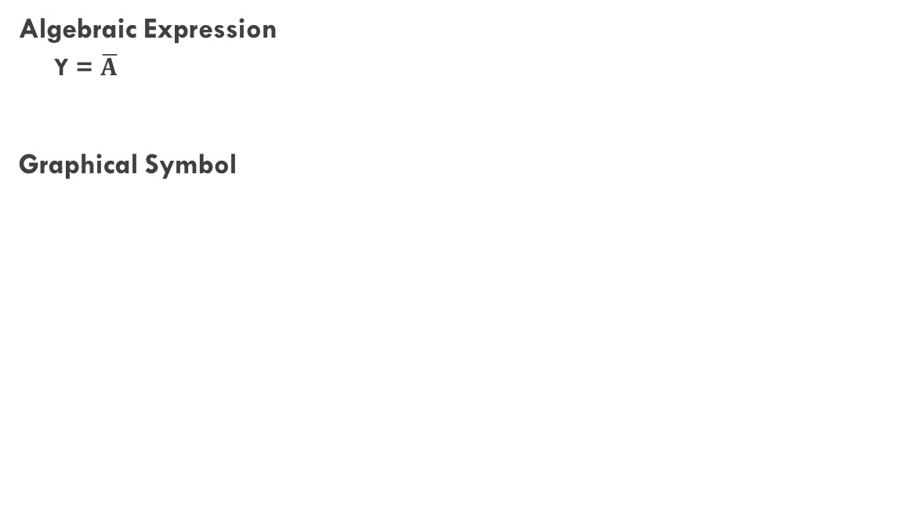
NOT Gate
An electronic circuit have only one input values and produce only one output value
Produce complement of input value
Truth Table
Algebraic Expression
Y = $\overline{A}$
Graphical Symbol
Inputs | Outputs
A | Y = $\overline{A}$
0 | 1
1 | 0

Slide 29
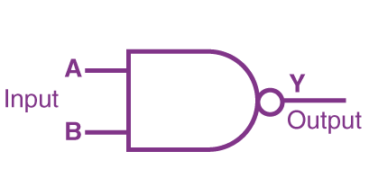
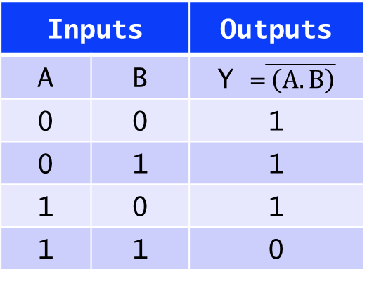
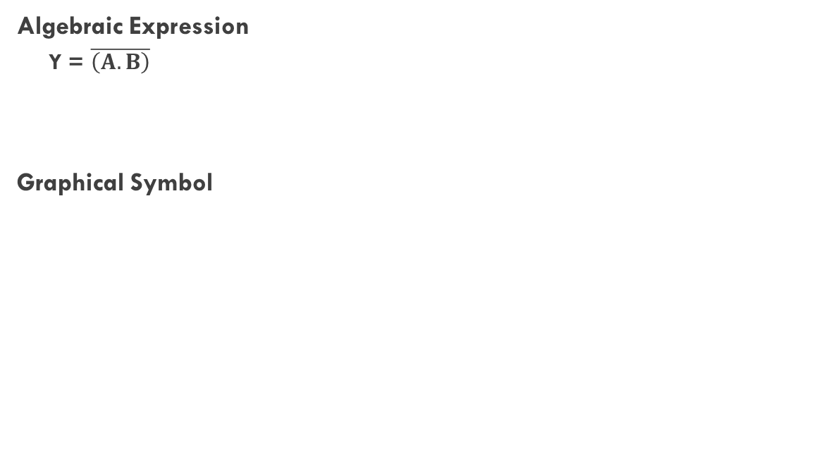
NAND Gate
An electronic circuit have two or more than two input values and produce only one output value
Combination of AND and NOT gate
Truth Table
Algebraic Expression
Y = $\overline{\left(A.B\right)}$
Graphical Symbol
Inputs |  | Outputs
A | B | Y =$\overline{ \left(A.B\right)}$
0 | 0 | 1
0 | 1 | 1
1 | 0 | 1
1 | 1 | 0

Slide 30
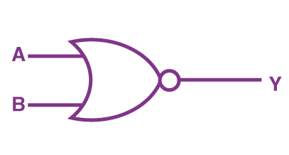
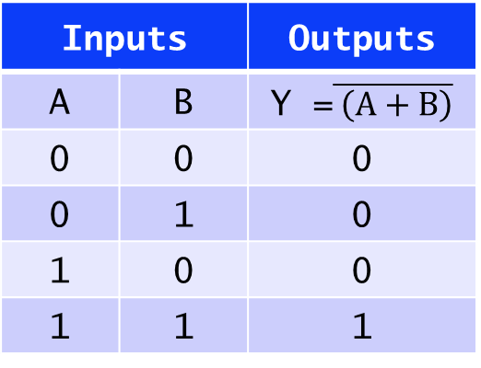
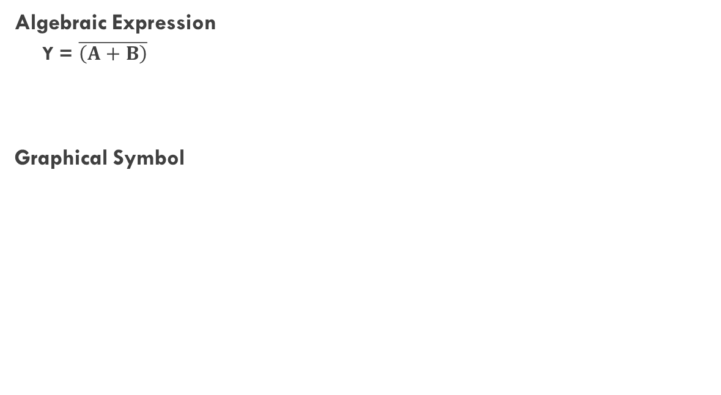
NOR Gate
An electronic circuit have two or more than two input values and produce only one output value
Combination of OR and NOT gate
Truth Table
Algebraic Expression
Y = $\overline{\left(A+B\right)}$
Graphical Symbol
Inputs |  | Outputs
A | B | Y =$\overline{ \left(A+B\right)}$
0 | 0 | 0
0 | 1 | 0
1 | 0 | 0
1 | 1 | 1

Slide 31

Thank You

